Slide 1
Expanding Masculinities in a Competitive Research Culture
Round table_ADBIS conference, Bayonne, 30 August 2024
Rita Bencivenga, Department of Civil, Chemical and Environmental Engineering, University of Genoa, Italy

Slide 2
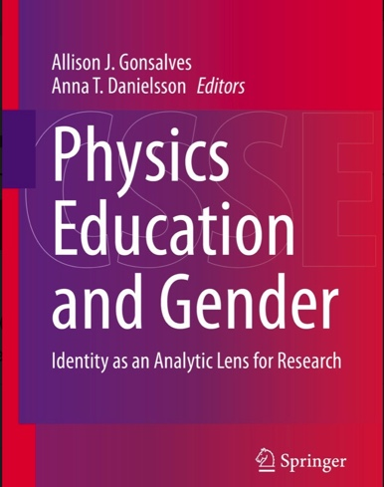
https://link.springer.com/book/10.1007/978-3-030 419332?source=shoppingads&locale=enit&gad_source=1&gclid=CjwKCAiA7t6sBhAiEiwAsaieYkjrfVeQQ76v9h8abSJz8sssT-AIhNjXkWhtTg_an_Wf64OMigVTdRoCJ3IQAvD_BwE

Slide 3
Chapter 4 An Intersectional Physics Identity Framework for Studying Physics Settings Angela Johnson
Chapter 8
Disability in Physics: Learning
from Binary Mistakes
Adrienne Traxler and Jennifer Blue

Slide 4
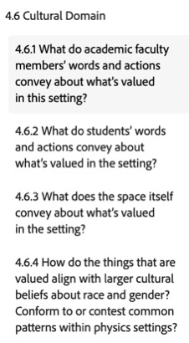
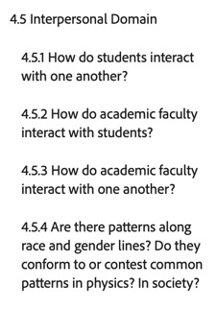
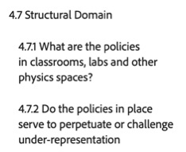
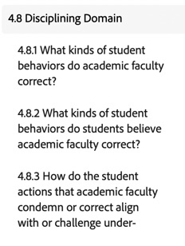
Chapter 4 An Intersectional Physics Identity Framework for Studying Physics Settings Angela Johnson

Slide 5
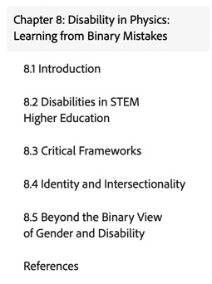
Chapter 8
Disability in Physics: Learning
from Binary Mistakes
Adrienne Traxler and Jennifer Blue

Slide 6
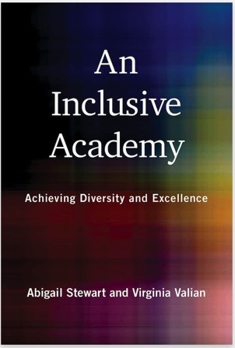
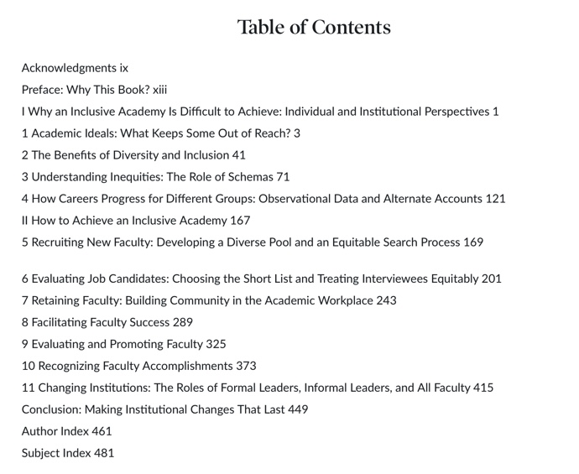
Published: October 11, 2022 Publisher: The MIT Press
https://mitpress.mit.edu/9780262545266/an-inclusive-academy/

Slide 7
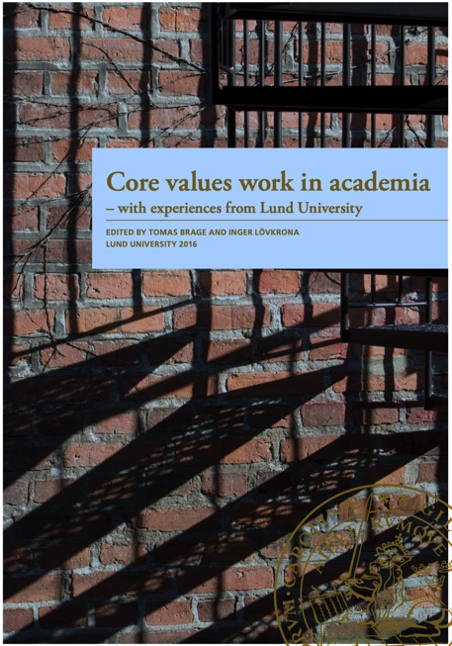
Core values work in academia
What are core values and what use are they?
How can the central government core values translate to academia?
Why do the ‘statutory’, political values end up in conflict with academic values based on the specific culture of universities?
What methods and what examples exist for active and effective core values work at a university?
And how do you implement core values so that they are present and meaningful within the organisation?
This report from the “Core values project at Lund University” attempts to answer these questions, problematise various values and provide support for core values work at a ‘typical’ university.
It provides examples of methods which can be applied in core values work, such as a deeper understanding of discrimination and master suppression techniques, norm criticism and inclusive teaching.
https://eige.europa.eu/sites/default/files/core_values_work_brage_lovkrona.pdf

Slide 8
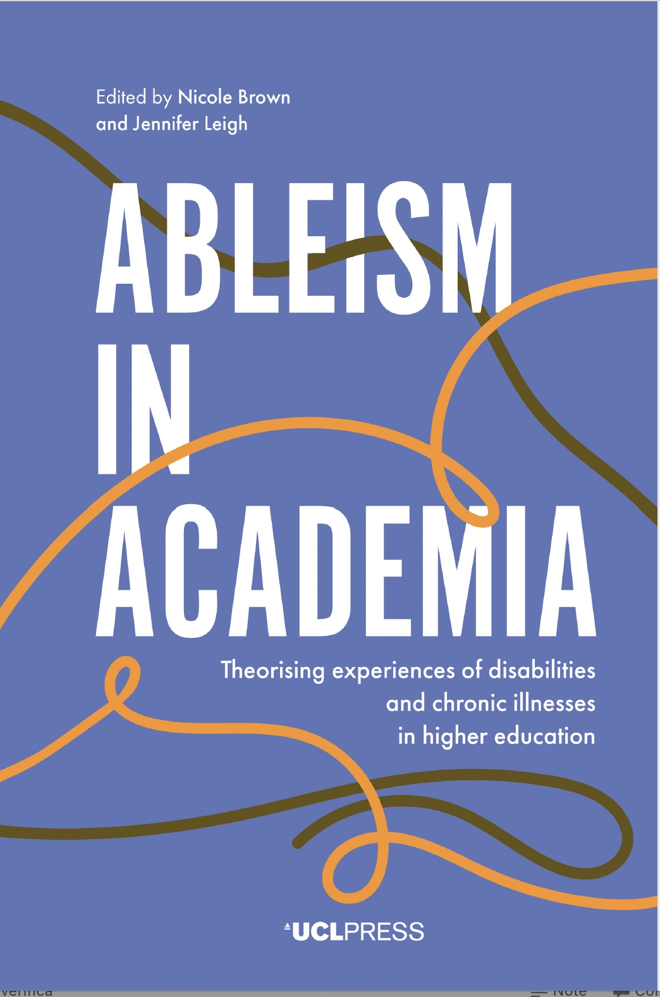
https://uclpress.co.uk/book/ableism-in-academia/

Slide 9
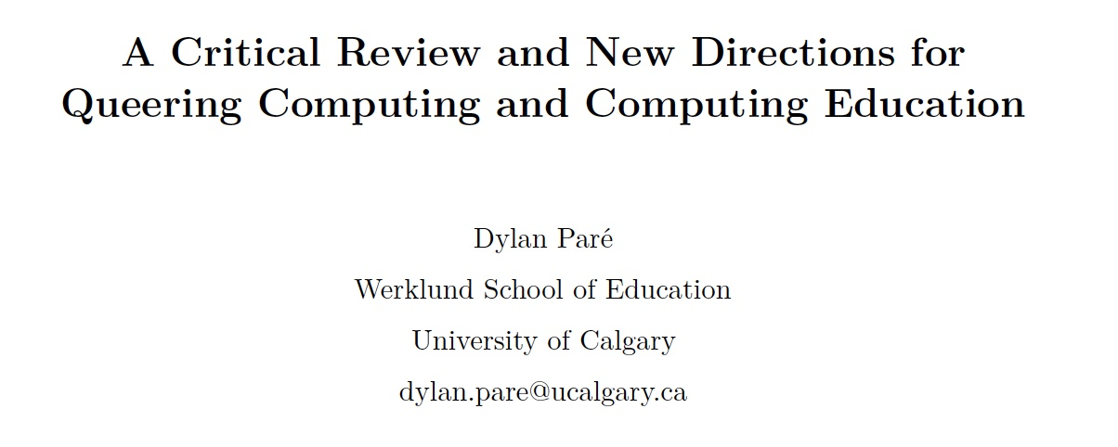
Paré, Dylan. 2021. “A Critical Review and New Directions for Queering Computing and Computing Education.”
In George Noblit (Ed.), Oxford Research Encyclopedia of Education. New York: Oxford University
Press. doi:10.1093/acrefore/9780190264093.013.ORE_EDU-01524.R1
https://oxfordre.com/education/display/10.1093/acrefore/9780190264093.001.0001/acrefore-9780190264093-e-1524

Slide 10

« Pour une scientifique que l’on oublie, ce sont des centaines qui ne naissent pas. »
Au secours de la mémoire d’une ingénieure menacée d’oubli, cette première biographie consacrée à Alice Recoque – disparue en 2021 – est une réponse à l’invisibilisation des femmes scientifiques.
Cette enquête inédite est aussi un manifeste pour la réhabilitation des grandes figures savantes capables d’inspirer les générations futures.

Slide 11
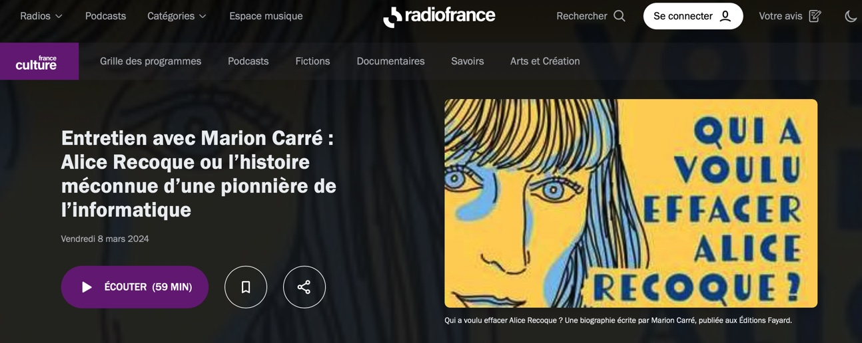
https://www.radiofrance.fr/franceculture/podcasts/le-meilleur-des
-mondes/entretien-avec-marion-carre-alice-recoque-ou-l-histoire
-meconnue-d-une-pionniere-de-l-informatique-3061411

